Slide 1
Introduction to Java

Slide 2
Installation
First, head over to this site and download IntelliJ IDEA community edition.
Continue with the installation wizard. The default options will work fine.
Select “Reboot now” when installation is complete.
Open Intellij then select “Create new project”

Slide 3
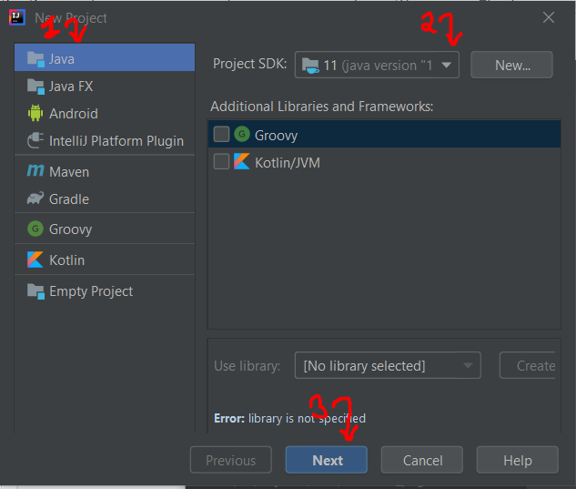
Installation
Select Java
You will not have a project SDK select. So click on the drop down menu and select “download JDK”

Slide 4
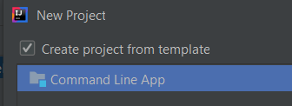
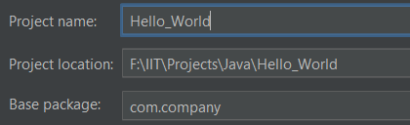
Installation
If, for some reason, you don’t see the download option, go here and download for yourself.
When done, select the download folder in intelliJ project SDK option.
3. Click on next, then this -

Slide 5
Hello World

Slide 6
Hello World
Examine your starting files.
Src is where all your code will reside.
Com.company is the package name (unless you have changed it)
Packages are just collections of files each of which contains some code.
Main is starter file for any Java program.

Slide 7
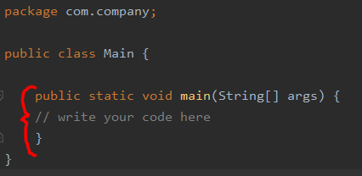
Hello World
We will talk more about classes and packages. For now, just know that this main function is the entry point of a java program

Slide 8
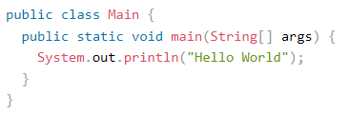
Hello World
And Hello World!
Shortcut for print statements - type sout and hit enter.

Slide 9
Comments
You might have noticed that write your code here is commented.
You can have single line comments - //
Or block comments - /* … … */
In IntelliJ, add comments quickly by pressing ctrl + / or ctrl + shift + /
Select some lines of code and try them out!

Slide 10
Data and I/O

Slide 11
Variables
Variables are containers for storing data values.
In Java, there are different types of variables, for example:
String - stores text, such as "Hello". String values are surrounded by double quotes
int - stores integers (whole numbers), without decimals, such as 123 or -123
float - stores floating point numbers, with decimals, such as 19.99 or -19.99

Slide 12


Variables
char - stores single characters, such as 'a' or 'B'. Char values are surrounded by single quotes
boolean - stores values with two states: true or false
Syntax - type variableName = value;

Slide 13

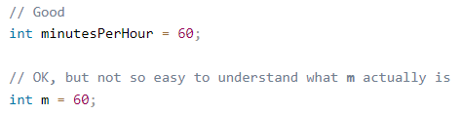
Variables
Be careful when naming variables -

Slide 14
Data types
Data types in Java -
int - 4bytes - Stores whole numbers from -2,147,483,648 to 2,147,483,647
float - 4 bytes - Stores fractional numbers. Sufficient for storing 6 to 7 decimal digits
double - 8 bytes - Stores fractional numbers. Sufficient for storing 15 decimal digits
boolean - 1 byte - Stores true or false values.

Slide 15
Data types
Data types in Java (continued)-
char - 2 bytes - Stores a single character/letter
String (with capital s) - Stores a sequence of characters

Slide 16
Basic I/O in Java
We have already discussed about “sout” or System.out.println() which prints data to console.
System.out.println() also prints an empty line (new line character or “\n”) at the end.
If that is not desired, then System.out. print() can be used.

Slide 17
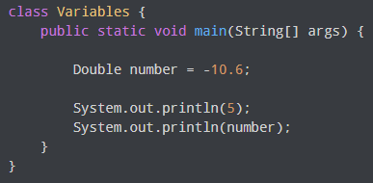
Basic I/O in Java
Examples -

Slide 18
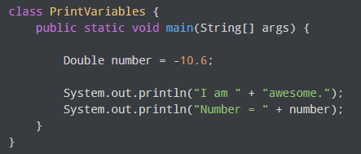
Basic I/O in Java
Examples -

Slide 19


Basic I/O in Java
For inputs, we will be using the Scanner class.
But the code for scanner class is elsewhere. We need to import it first
Scanner is class. It has code (functions) and data wrapped as a single entity.

Slide 20
Basic I/O in Java
With the keyword new, we instantiate the class. I.e., make a copy of the class. We have captured this copy in the variable input.
Here Scanner acts as a template. We can make as many changes to input without affecting Scanner. And we can make as many copies of Scanner as we wish.
Once you understand this, we can move on to actually taking inputs.

Slide 21
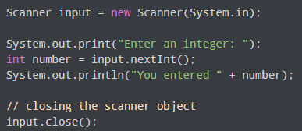
Basic I/O in Java
Get an integer from the user -

Slide 22
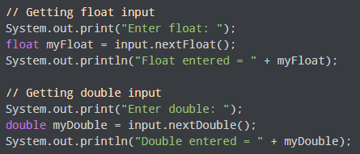
Basic I/O in Java

Slide 23

Basic I/O in Java
If you want to read line by line, you can use input.nextLine() instead of input.next()

Slide 24
Operators

Slide 25
Operators in Java
Arithmetic operators are addition (+), subtraction (-), multiplication (*), division (/), modulus (%), increment (++), decrement (--)
Ex -
System.out. println(13 % 5); // 3
Int x = 5;
x++;
System.out. println(x); // 6

Slide 26
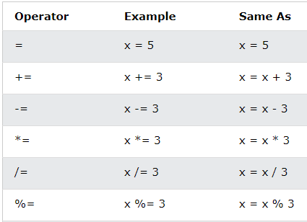
Operators in Java
The arithmetic operators can be used with = sign as assignment operator. Ex -

Slide 27
Strings

Slide 28
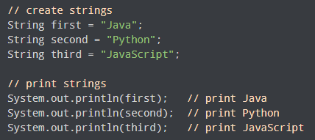
Strings
In java, strings are represented by double quotes. Ex -

Slide 29
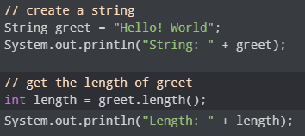
String operations
Length of a string -

Slide 30
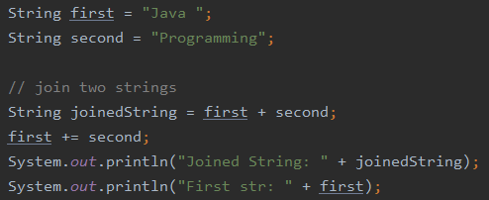
String operations
String concatenation - Strings can be concatenated with + sign.

Slide 31
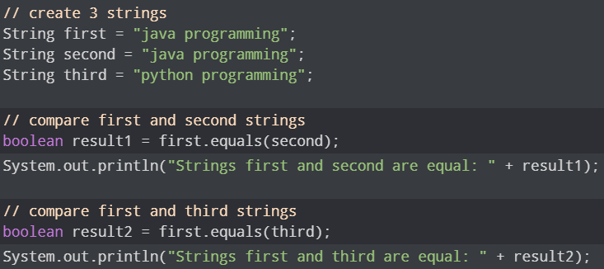
String operations
String comparison - N.B. (The == sign doesn’t work as expected)

Slide 32


String operations
Suppose we need to include double quotes inside a string.
Since strings are represented by double quotes, the compiler will treat "This is the " as the string. Hence, the above code will cause an error.
To solve this issue, we use the escape character \ in Java. For example,

Slide 33
Math and conditions

Slide 34
Java Math
The Java Math class has many methods that allows you to perform mathematical tasks on numbers -
Math.max(5, 10); // 10
Math.min(5, 10); // 5
Math.sqrt(64); // 8
Math.abs(-4.7); // 4.7
Math.random(); // returns a random number between 0.0 (inclusive), and 1.0 (exclusive):

Slide 35
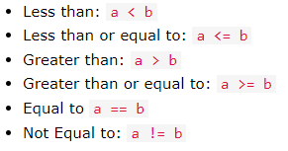
Java Boolean
Booleans can only take two values : true or false.
Using any logical operators will return boolean values -
Other logical operators -

Slide 36
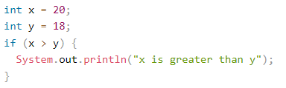
Java If/Else
The if statement -

Slide 37
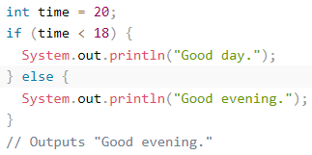
Java If/Else
The if/else block -

Slide 38
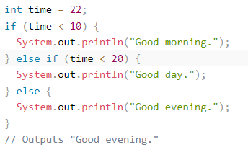
Java If/Else
The if/else if/ else block -

Slide 39
Java If/Else
In the example on the last slide, time (22) is greater than 10, so the first condition is false.
The next condition, in the else if statement, is also false, so we move on to the else condition since condition1 and condition2 is both false - and print to the screen "Good evening".
However, if the time was 14, our program would print "Good day."
Then it would not bother to check any other else if or else statements in this block and jump to the end of the if/else if/else block.

Slide 40
Loops

Slide 41
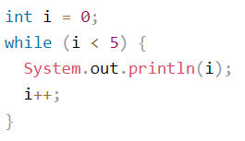
Java Loops
Loops can execute a block of code as long as a specified condition is reached.
Loops are handy because they save time, reduce errors, and they make code more readable.
Look at this code. What does it do?

Slide 42

Java Loops
The other type of loops would be for loops.
When you know exactly how many times you want to loop through a block of code, use the for loop.
Syntax -

Slide 43
Java Loops
Statement 1 is executed (one time) before the execution of the code block.
Statement 2 defines the condition for executing the code block.
Statement 3 is executed (every time) after the code block has been executed.

Slide 44


Java Loops
For example, this prints all numbers from 0 to 4
This prints all even numbers from 0 to 10

Slide 45
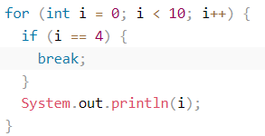
Java Loops: break
The break statement can also be used to jump out of a loop.
This example stops the loop when i is equal to 4:

Slide 46
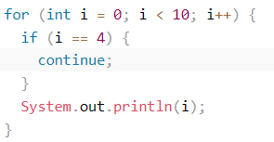
Java Loops: continue
The continue statement breaks one iteration (in the loop), if a specified condition occurs, and continues with the next iteration in the loop.
This example skips the value of 4:

Slide 47
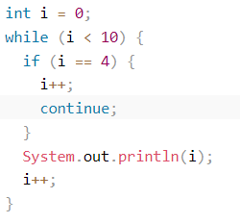
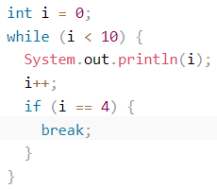
Java Loops: break and continue
You can also use break and continue in while loops.

Slide 48
Thank you

Slide 49
Exercises
Write a program that:
Takes user’s last name and greets them with like so - “Hello, James!”
Takes user’s first and last name and greets them like - “Hello, James Brown!”
Takes user’s name, and gender. If gender is “male”, the he is greeted as Mr. If the gender is “female”, then she is greeted as Ms. For any other input, neither Mr. or Ms. is to be mentioned.

Slide 50
Exercises
Write a program that:
Takes user’s full name and their age, and displays the inputs on screen.
Takes user’s full name, age, weight, and cell phone number, and prints them on the console, separated by i) line breaks and ii) by commas
Prints all numbers from 1 to 10 ONLY.
Prints all numbers from 1 to 100 ONLY.

Slide 51
Exercises
Write a program that:
Prints all numbers from 20 to 55 only.
Takes an input number from user, then prints all numbers from 1 to 10, except the input number.
Prints all numbers between two numbers taken as input.
Takes an integer input and tells if the integer is odd or even
Takes an integer input and prints its square root.
Print all odd numbers between 1 to 100

Slide 52
Exercises
Exercises from beecrowd.com -
Link
Link
Link
Link
Link
Link
Link
Link
Link
Link

Slide 53
Exercises
Exercises from hackerrank.com -
Link
Link
Link
Link
Link
Link
Link
Link
Link
Link

Slide 54
Exercises
Exercises from codeforces.com -
Link
Link
Link

Slide 55
Thank you

